Slide 1
Computing through the decades.
The development of computing
Electronic computers were first used in the 1940s.
This presentation is designed to give you an overview of some of the important developments in computing since then.
You will need to research and think about other developments and how they relate to business use in order to succeed in this unit.

Slide 2
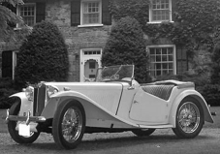

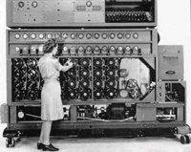
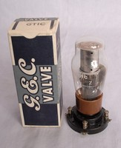
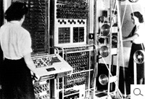
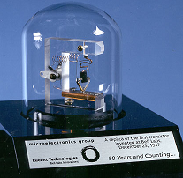
Computing through the decades.
The 1940s
The Bombe Computer – 1941
Electro-mechanical
Only one purpose- to decode military messages
The Colossus Computer – 1944
Electronic operation, using valves
Still only one purpose- to decode military messages!
Invention of transistors – 1947
Replaced valves
Computers started to get smaller

Slide 3
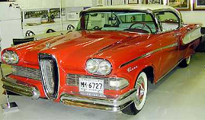

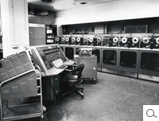
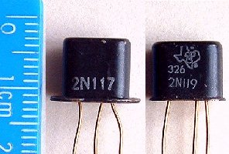
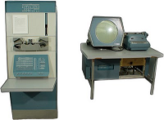
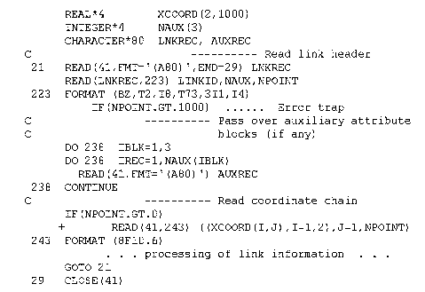
Computing through the decades.
The 1950s
UNIVAC – 1951
First commercial computer
Cost: $750,000
Digital Equipment Co. - 1957
DEC made minicomputers that were more useable in the 1960s and 70s
Silicon transistors 1954
Getting even smaller!!
Fortran – 1957
Writing programs in Fortran meant that computers were no longer single purpose.
The programmer could make them do anything!

Slide 4
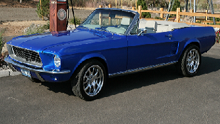
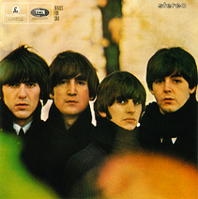

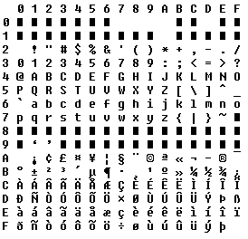
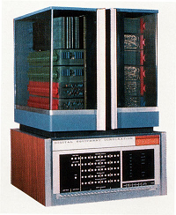
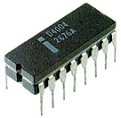
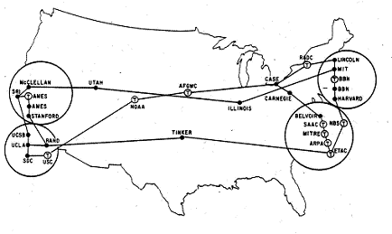
Computing through the decades.
The 1960s
ASCII Standard - 1963
First computing standard developed – allows computers to communicate with each other
Intel founded – 1968
DEC PDP8 – 1965
Priced at $18,000
First true minicomputer allowed thousands of medium sized businesses access to computing power
ARPANET project goes live – 1966
Packet switching protocol developed
Becomes the basis for the Internet

Slide 5
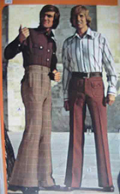
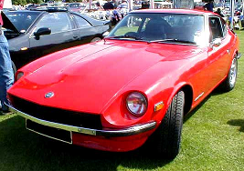
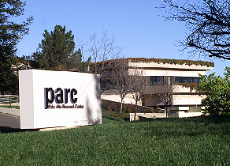
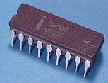
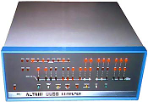
Computing through the decades.
The 1970s
Xerox opens Palo Alto Research Centre – 1970 Developments:
Bitmap graphics
Graphical User Interface (GUI) featuring windows and icons
The mouse
Ethernet local-area computer network
Object oriented programming
Intel 8008 chip – 1972
Normalisation rules developed for relational database design - 1970
Altair 8800 - 1975
8 bit processor
clock rate 500 kHz
number of transistors 3,500
addressable memory 16 KB
First email sent - 1971
DES encryption adopted by US government - 1976

Slide 6
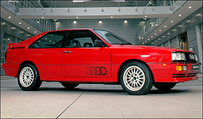
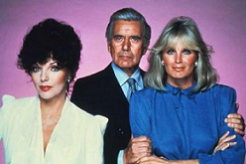
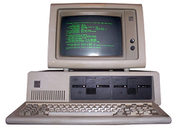
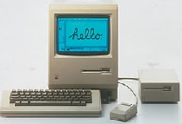
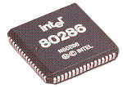
Computing through the decades.
The 1980s
IBM PC - 1980
Used MS DOS operating system
IBM allowed other manufacturers to use the system architecture
Intel 286 CPU chip – 1982
C++ programming language - 1980
Apple MAC - 1984
Used a mouse and a GUI
Did not use a Command Line Interface
16 bit processor
clock rates 16 MHz, 20 MHz and 25 MHz number of transistors 134,000
addressable memory 16 MB

Slide 7


1991
The NSF allowed commercial use of the Internet* for the first time in 1991
1995 - NSF decommissioned the backbone, leaving the Internet a self-supporting industry.
Tim Berners-Lee puts his WorldWideWeb browser and web server software online.
The Web began to take off as computer enthusiasts around the world began setting up their own web servers.
*By now, the ARPANET had evolved into the Internet.

